Slide 1






Classifying
Poisonous
Mushroom
Prediction using Machine Learning
By Monisha Das
7/10/2024

Slide 2


Project Overview
Objective: To predict whether a mushroom is edible or poisonous using features like gill color, cap shape, and other attributes.
Tools used: Google Colab , Microsoft PPT , Canva , Google
Number of records : 61070 and number of features :21
Features include cap shape, cap diameter, stem height, stem width etc
Target: Classifying mushrooms as edible or poisonous.

Slide 3
Data Preprocessing
Load Data on Google Colab and read the file
Check shape, summary and missing values in the data
Get missing value percentage for the features with missing values
Got 8 features with missing value % ranging from 4% to 94%.
Decided on dropping the features with more than 20% data missing as this will just add noise to the data

Slide 4
Data Preprocessing
So I am left with 2 features with missing values 4% and 16% and both the features are categorical in nature and so I decide on imputing the same with mode
Rechecking the data for any more null values
All the data is now cleaned

Slide 5
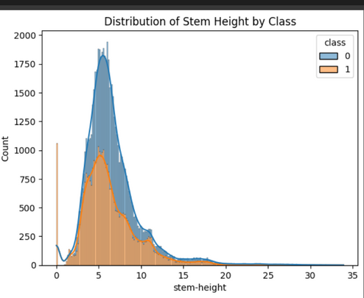
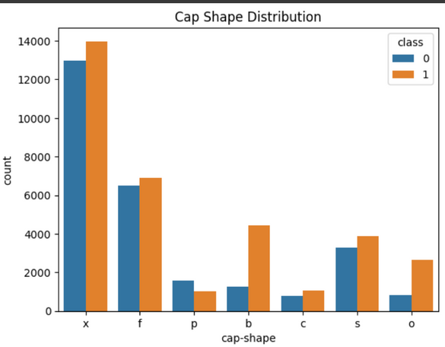
Exploratory Data Analysis (EDA)
Using Histplot for viewing numerical features
Using Countplot for viewing categorical features

Slide 6
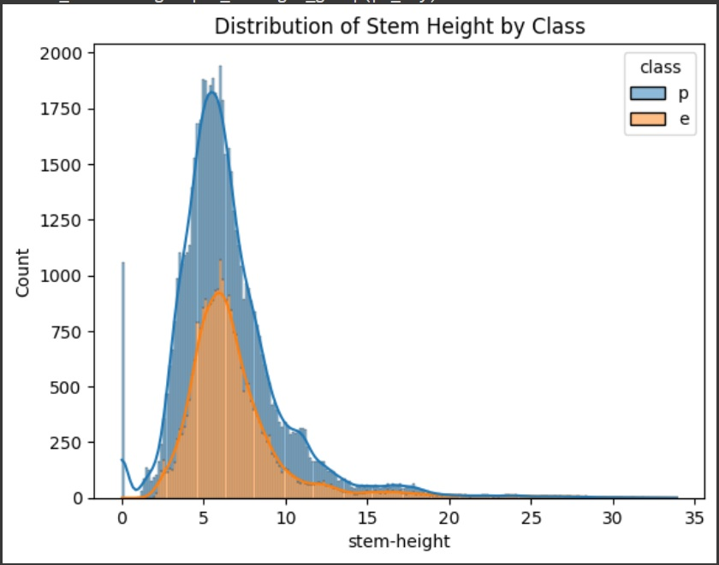
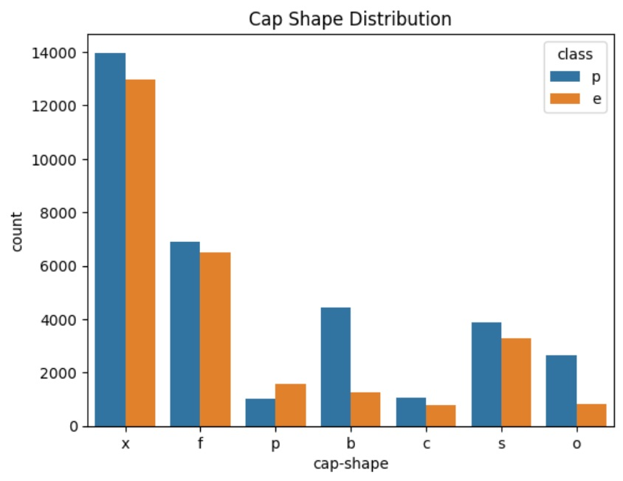
Exploratory Data Analysis (EDA)
Stem height clearly distinguishes between edible and poisonous class
Cap Shape provides little distinction which will be needed to find a pattern

Slide 7
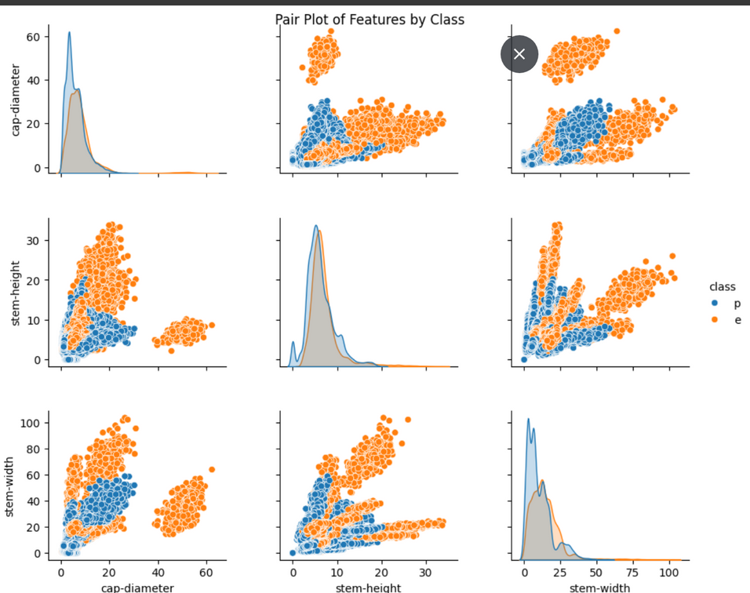
Exploratory Data Analysis (EDA)
Here I have used a pairplot to visualize between the numerical features on the basis of class
Class Separation: The distinct clusters of blue and orange show that these features are helpful in distinguishing between edible and poisonous mushrooms.

Slide 8
Exploratory Data Analysis (EDA)
Poisonous mushrooms (blue) generally have a broader range for cap and stem sizes compared to edible mushrooms (orange).
Stem Features: Stem-height and stem-width seem to have different distributions and relationships depending on the class, further aiding classification.

Slide 9
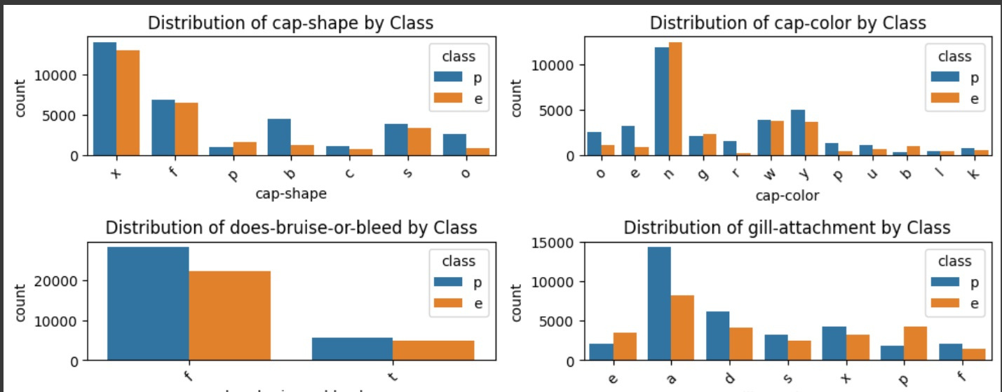
Exploratory Data Analysis (EDA)
I have visualized the categorical columns by countplot and all the features give some distinction required for finding patterns.

Slide 10
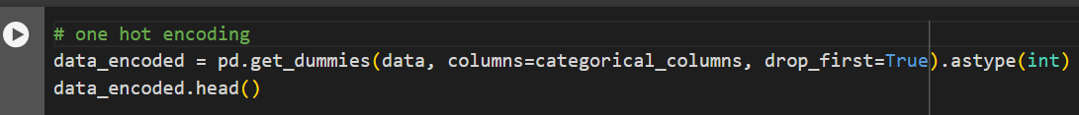
Data Encoding
The numerical columns don’t need encoding as Ml algo can read them directly, but for categorical columns we need to convert them to numerical format for ML algo to read.
All the categorical columns present are nominal in nature that is they don’t have any ranking as such, so here we should use one hot encoding which converts the categories to 0 and 1.

Slide 11
Data Splitting
Data is split into encoded_data that is the X value or features and data[‘class’] which is the Y value or the target.
Class column is mapped as edible :0 and poisonous :1
Data is split into train and test data by train_test_split from sklearns model selection package.
Train data :- 70% of the total data
Test data :- 30 % of the total data

Slide 12
Model Selection
Logistic Regression
Simplicity: A straightforward and interpretable model, making it an excellent starting point for binary classification problems.
Efficiency: Computationally less intensive, enabling quick training and evaluation.
Accuracy :- 76 %

Slide 13
Model Selection
Random Forest Classifier
Robustness: An ensemble method that reduces overfitting by averaging predictions from multiple decision trees, improving model generalization.
Capable of capturing complex relationships between features, making it suitable for diverse datasets.
Feature Importance: Provides insights into the importance of various features, aiding in model interpretation and feature selection.
Accuracy :- 99.83%
Performed cross-validation for checking the model
CV accuracy :-99.78%

Slide 14
Model Selection
XGBoost
High Performance: Known for its speed and accuracy, especially with large datasets and complex patterns.
Regularization: Incorporates L1 and L2 regularization to prevent overfitting, enhancing model robustness.
Parallel Processing: Utilizes parallelization for tree construction, significantly reducing training time compared to traditional gradient boosting algorithms.
Accuracy :- 99.69%

Slide 15
Model Selection
Since both random forest and xgboost is performing well for my model, I decided to do hyperparameter tuning for both the models.
Results post tuning :-
XGBOOST test accuracy :- 99.60%
Random Forest test accuracy :- 99.83%

Slide 16
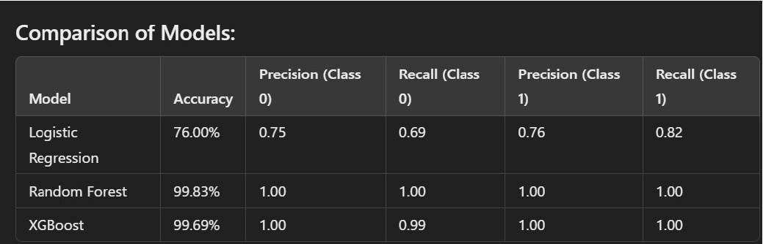
Conclusion

Slide 17
Conclusion
Random Forest was chosen because:
Accuracy: Random Forest achieved the highest accuracy at 99.83%.
Tuning: After hyperparameter tuning, there was no significant improvement in the performance of XGBoost or Random Forest, with Random Forest still performing better.
Interpretability: Random Forest is more interpretable compared to more complex models, making it easier to explain results to non-technical stakeholders.
Handling Overfitting: Random Forest is robust in reducing overfitting, performing well even with many features and handling noisy data effectively.

Slide 18
Thank you

